Slide 1
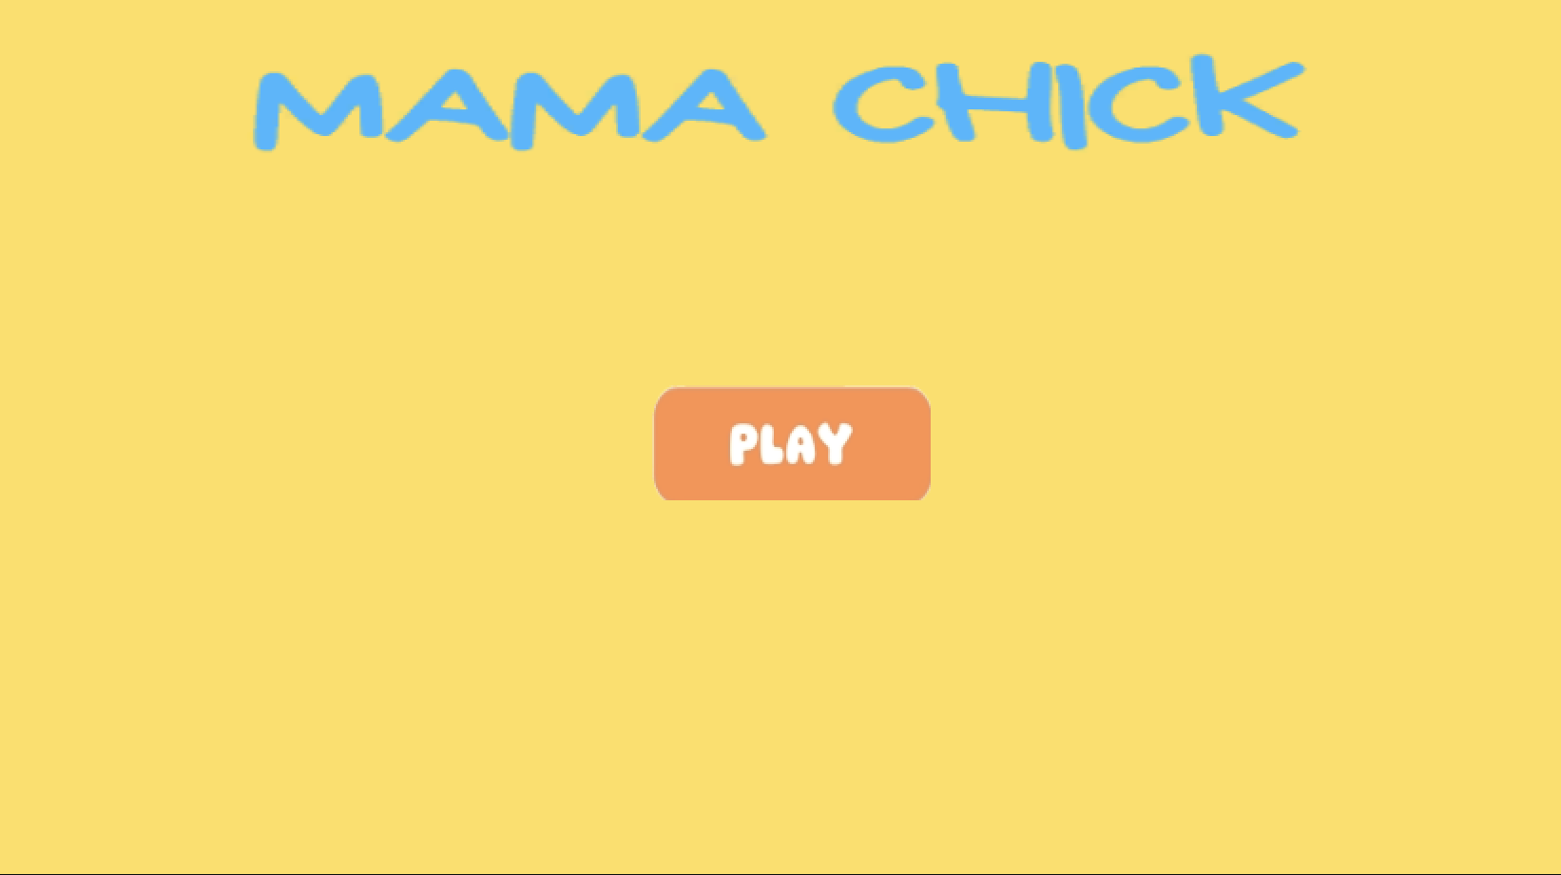
Mama Chick!
A journey of X -
CSCI 526 Gold Prototype Demo
CSCI 526 Gold Prototype Demo

Slide 2
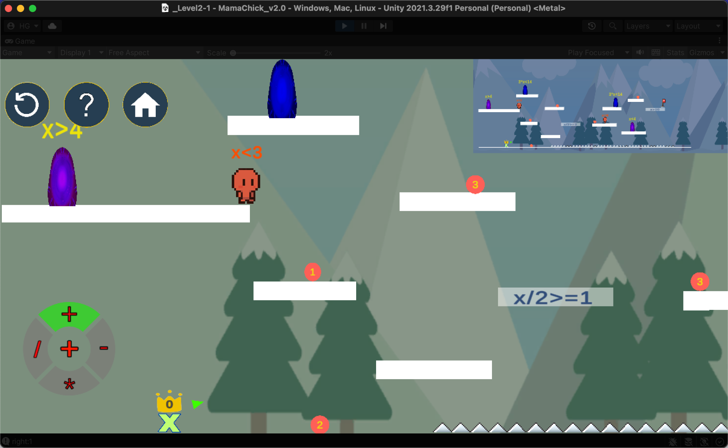






About Us
A PLATFORMER GAME FOCUSED ON MATH
A TEAM OF SIX DEVELOPERS

Slide 3
game mechanics

Slide 4
Game MECHANICS
Core mechanic:
Use player’s number as operand to strategically reach the end point
Supportive mechanics
Dial Menu of Operators
Equation platforms
Teleportation
Inverse gravity
Drag and Shoot
Elevator Platform
Gun
Monster
PowerUp ball

Slide 5
Mechanics | Description | Interaction with
Core mechanic | Use player’s number as operand to strategically reach the end point | Almost all other mechanics
Dial menu of operators | Player can choose operator(+,-,*,/) for calculation | Core,Gun,Monster
Equation platform | Player can only stand on equation platform if their number satisfy the equation | Core,Operator, Powerup ball
Teleportation | Player can use portal for teleport if their number satisfy equation of portal | Core,Operator
Inverse gravity | Player’s gravity is inverted if their number becomes negative | Core,Operator
Drag & Shoot | Player can drag number balls and throw them. If number ball hits a monster, monster will die and spawn a powerup ball | Elevator,Monster Powerup Ball
Elevator | Player can throw number ball to elevator, which will be triggered if the number ball satisfy its equation | Core,Drag & Shoot,Operator
Gun | Player can pick up a gun and shoot operator as bullets. Bullets can change the number of number ball or monster | Core,Operator Monster
Monster | Monsters’ size is related to its number. If their number become 0, they will die. | Core,Gun,Operator, Drag & Shoot
Powerup Ball | Player can pick up powerup ball and make all equation platforms solid | Equation platform, Monster

Slide 6
Three weeks ago..

Slide 7
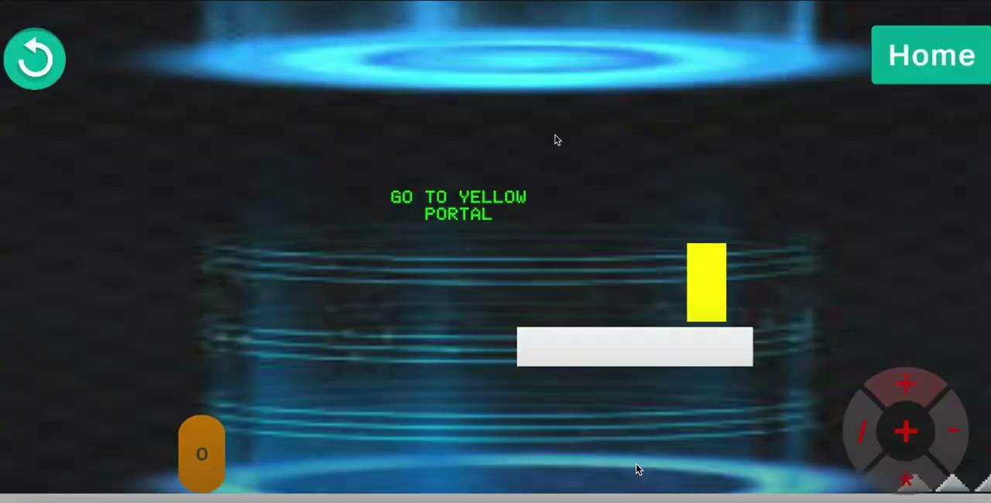
We used to look like this

Slide 8
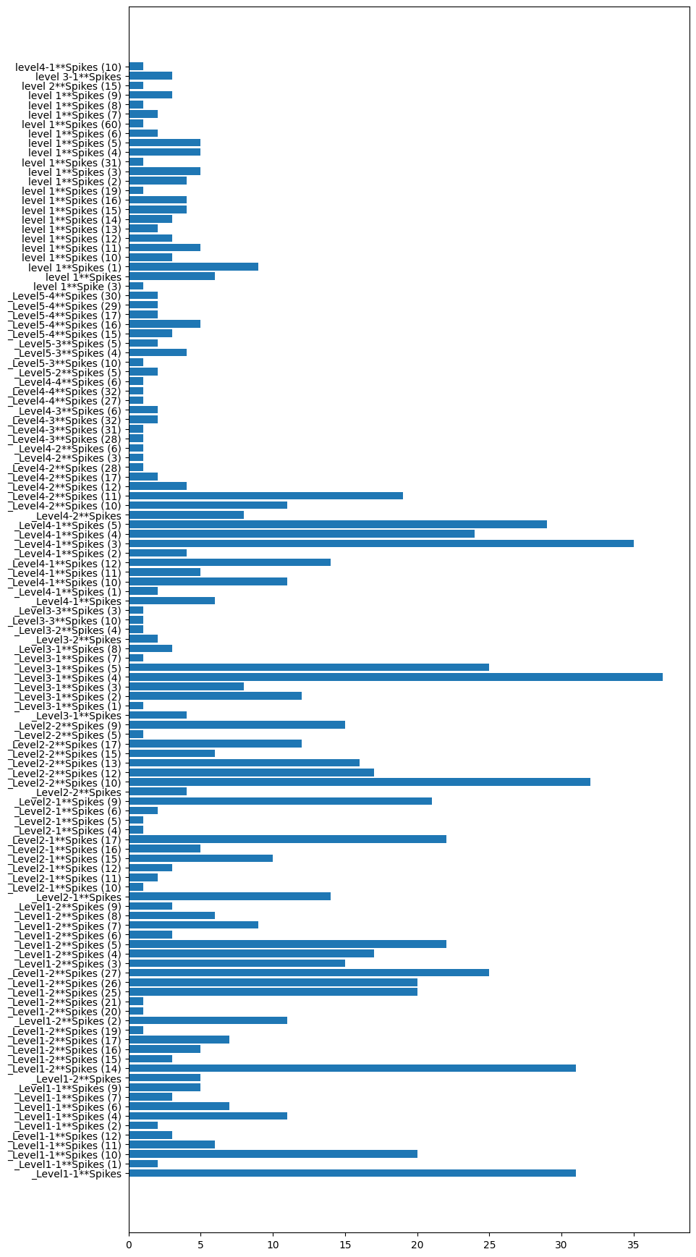
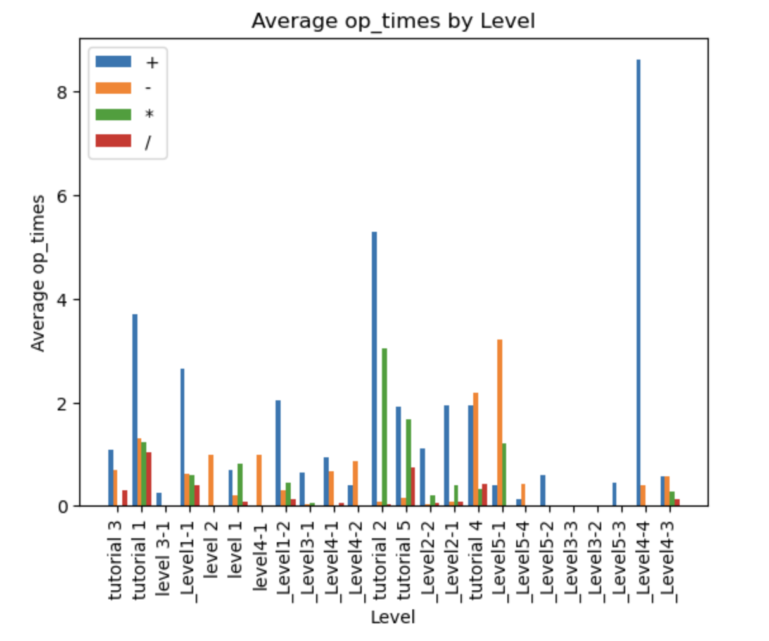
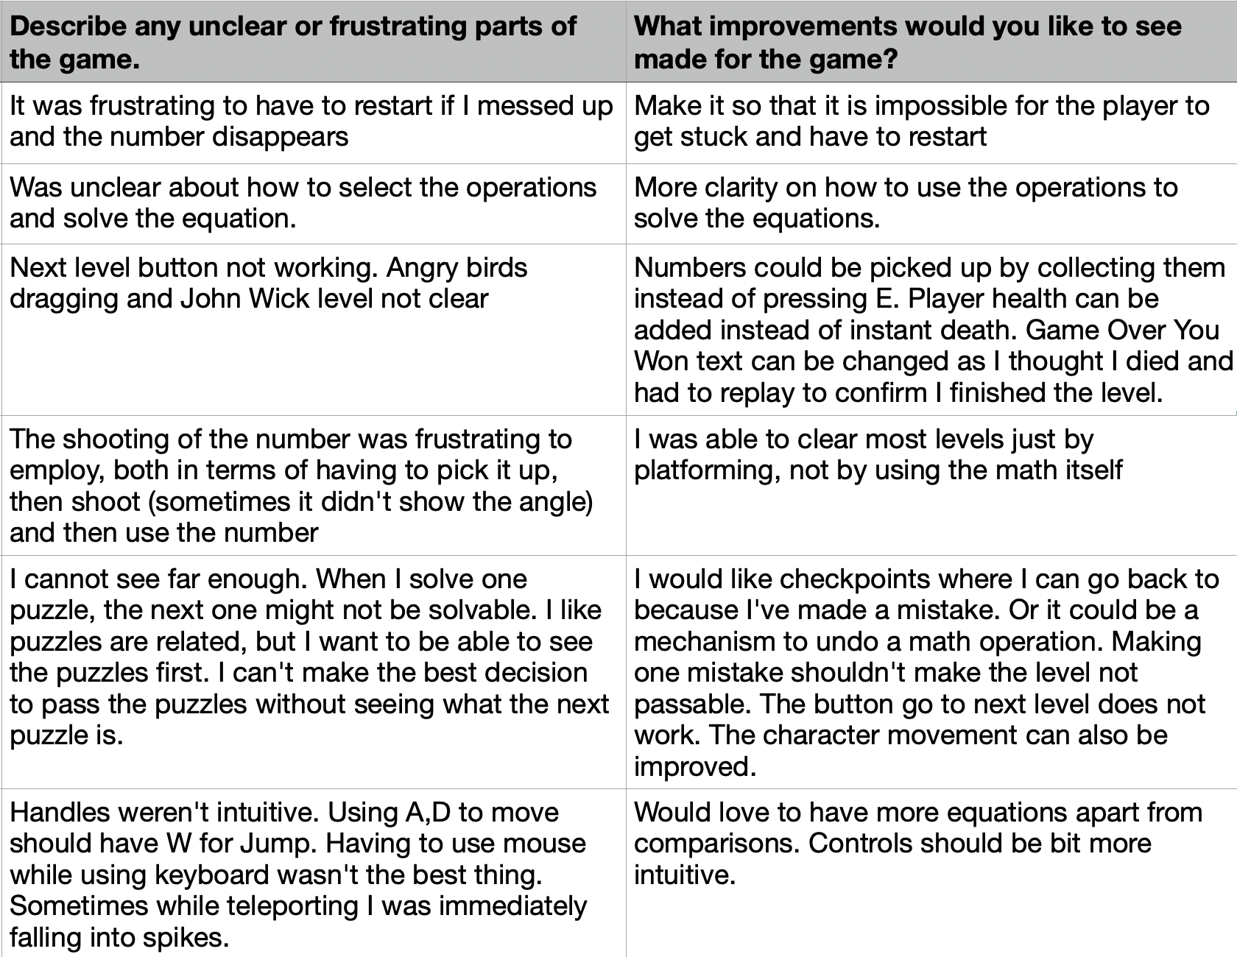
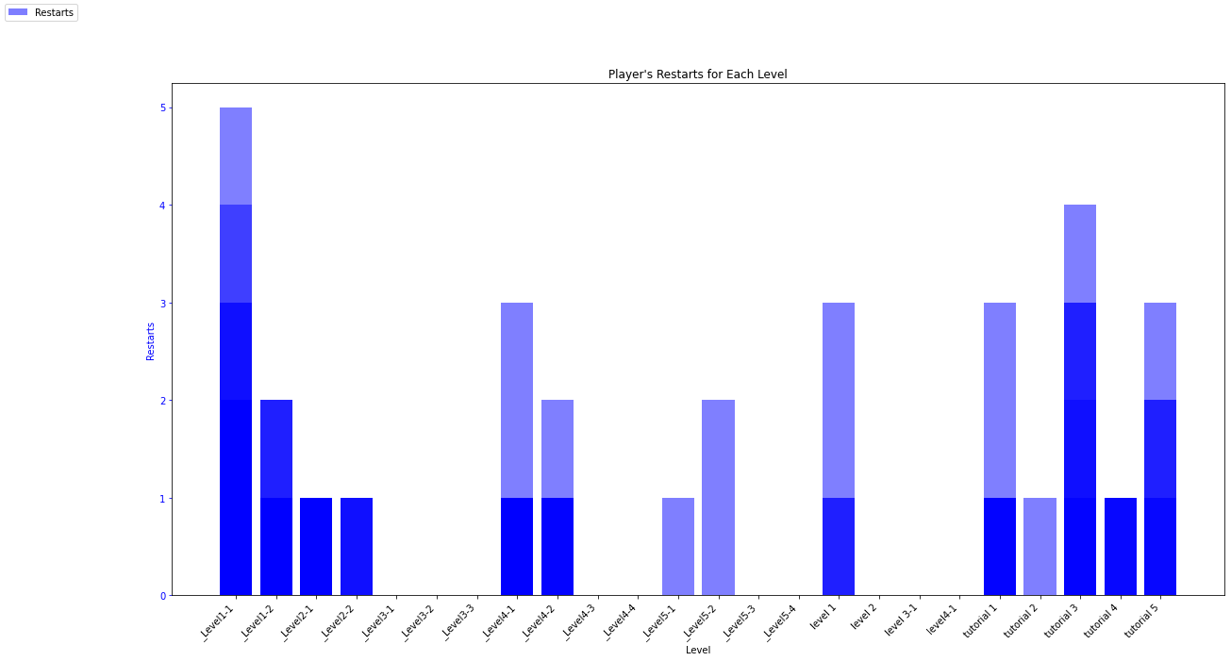
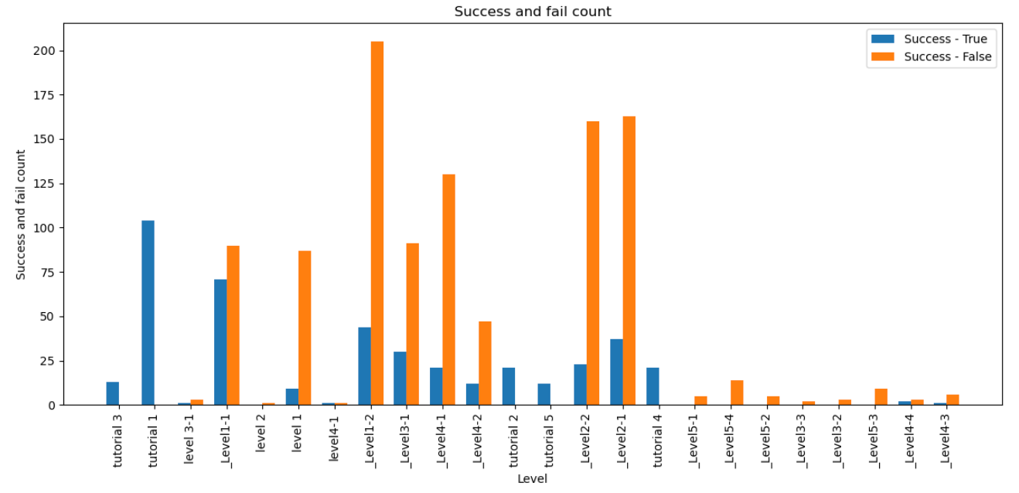
Thanks to your feedbacks!

Slide 9
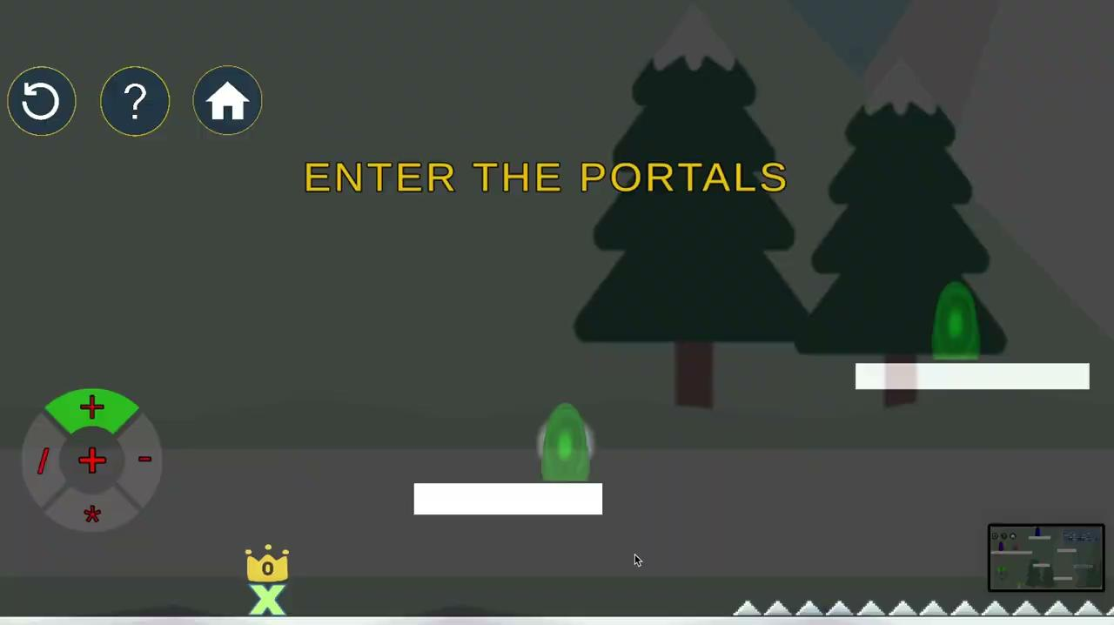
_Add newest video clip
Now we look like this!

Slide 10
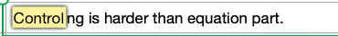

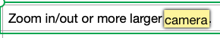
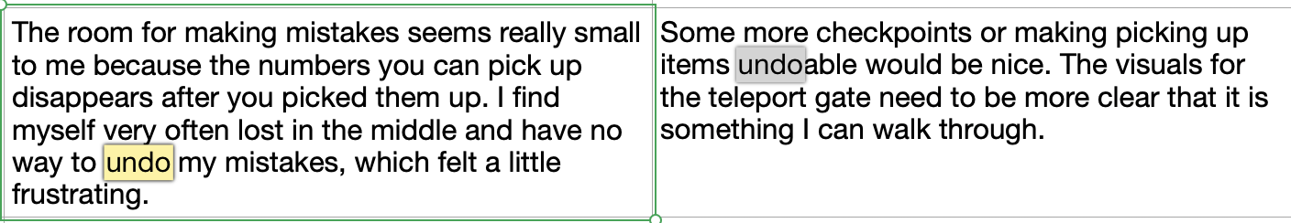
Most Frequent
Keywords:
Restart/Undo
View/Camera
Jump/Control
..
Feedback and Data Analysis

Slide 11
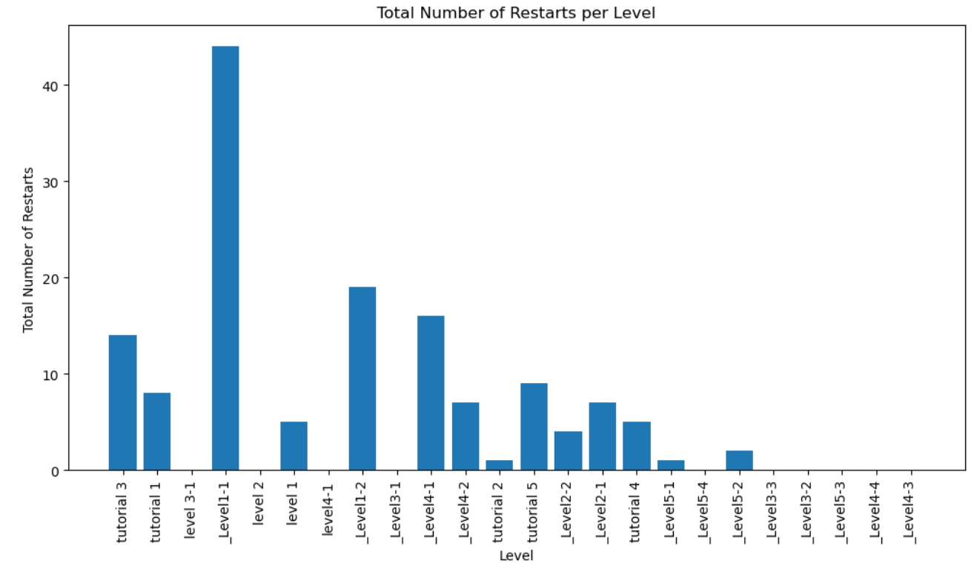
Low success rate
High restart frequency
Feedback and Data Analysis

Slide 12
Major Issues
Player Control
Tutorial
Camera
Flexibility
(Details Will Come Later)

Slide 13
1
Player control

Slide 14
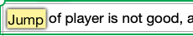

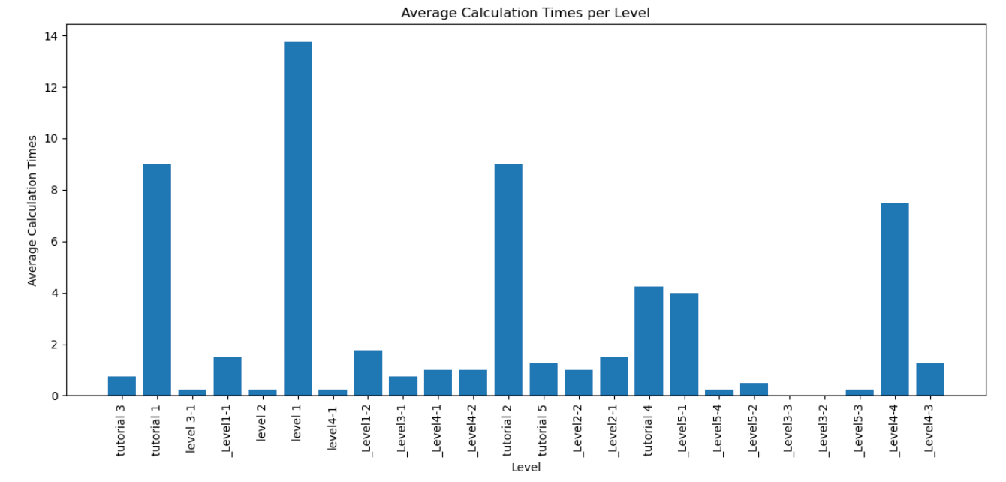
hypothesis
solutions
Jump is not that smooth and hard to control;
Control system is complicated
Adjust the jump parameters;
Reduce unnecessary key controls;
Adding more basic control;
Tutorials to enhance the memory of controls;
Adding help button

Slide 15
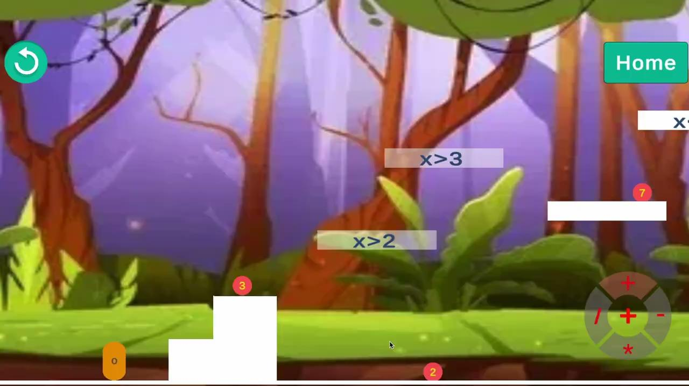
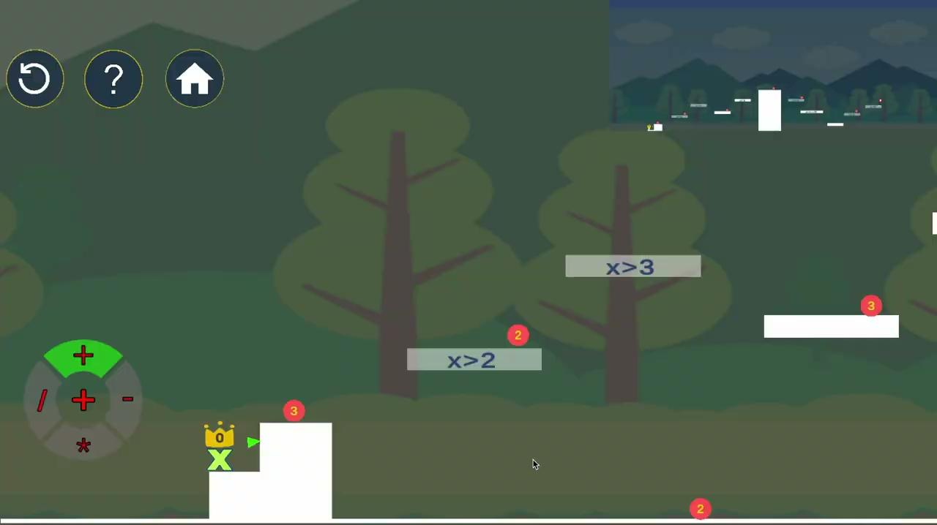
BETA
GOLD
INSERT VIDEO HERE
INSERT VIDEO HERE

Slide 16
2
tutorial

Slide 17
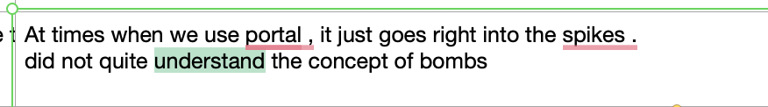
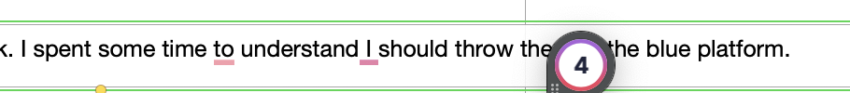
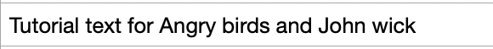
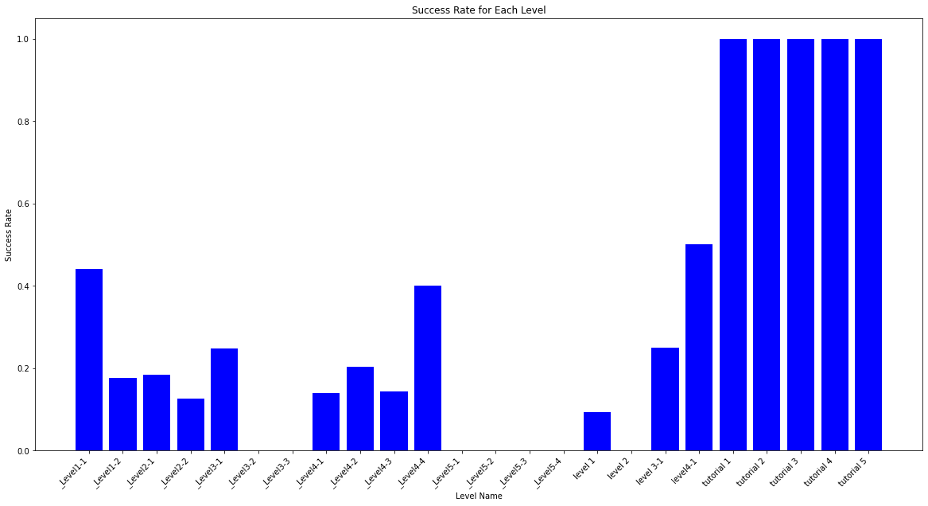
hypothesis
solutions
Small font
Clustered text
Unclear Instructions
Too much penalty
PUT DATA ANALYTICS HERE
Increase font
Minimize text
Better guidance design
Minimize penalty

Slide 18
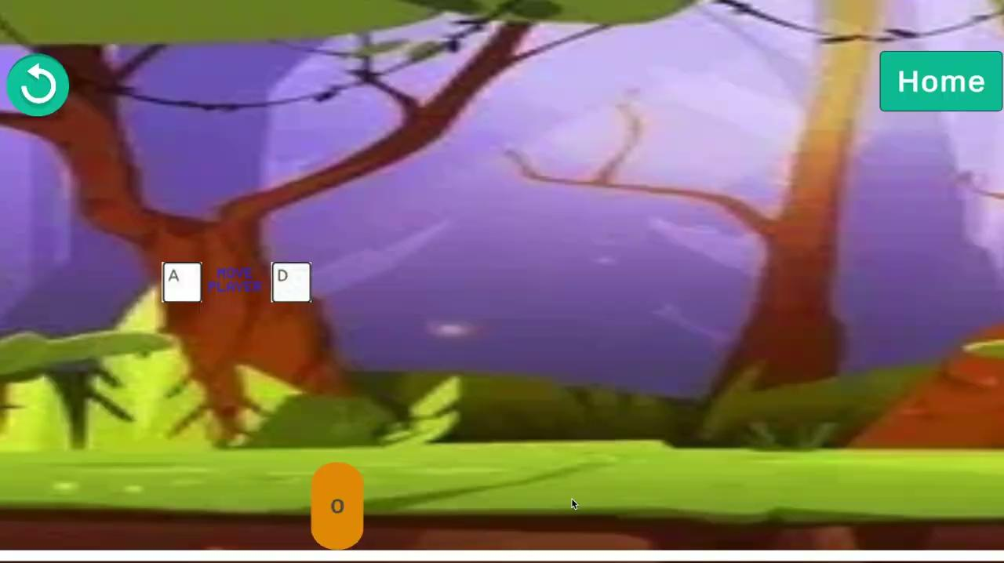
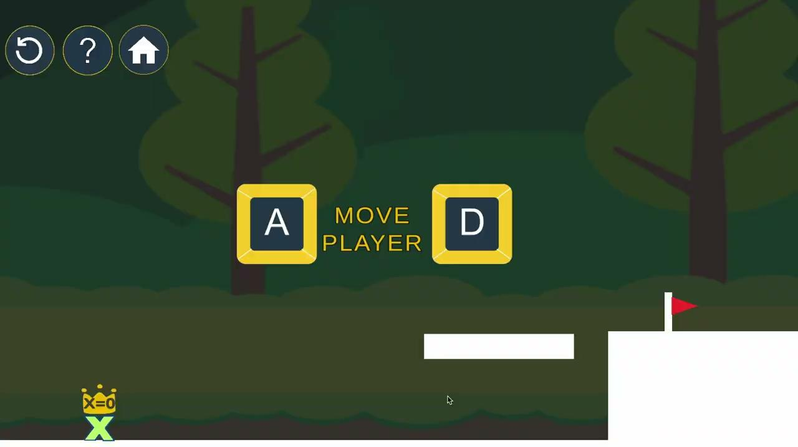
BETA
GOLD
INSERT VIDEO HERE
INSERT VIDEO HERE

Slide 19
3
CAMERA

Slide 20
hypothesis
solutions
Limited view
Players can’t tell the correct path
PUT DATA ANALYTICS HERE
Add an indicator to the end point
Adjust the camera for each level according to the level design
Add minimap

Slide 21
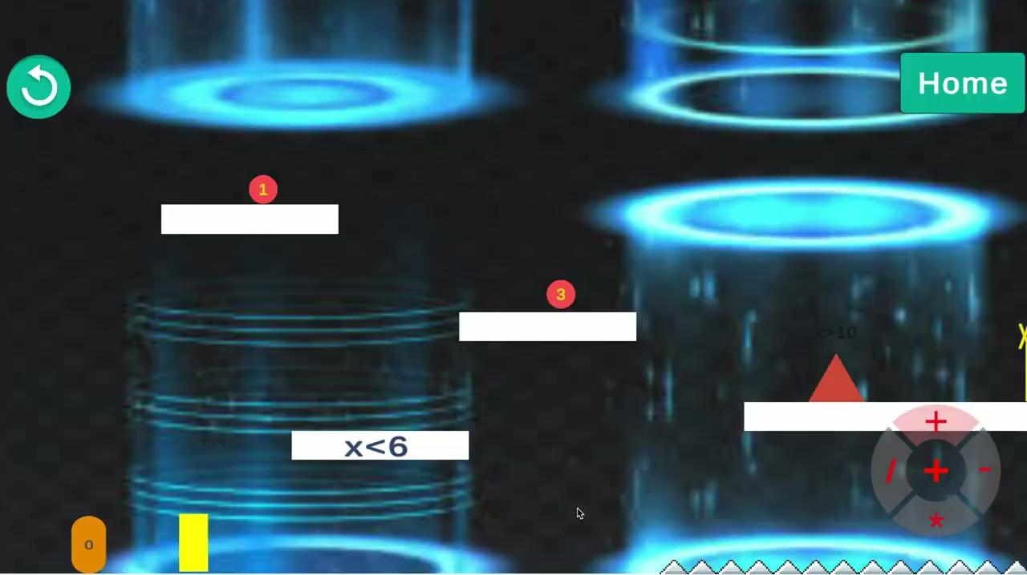
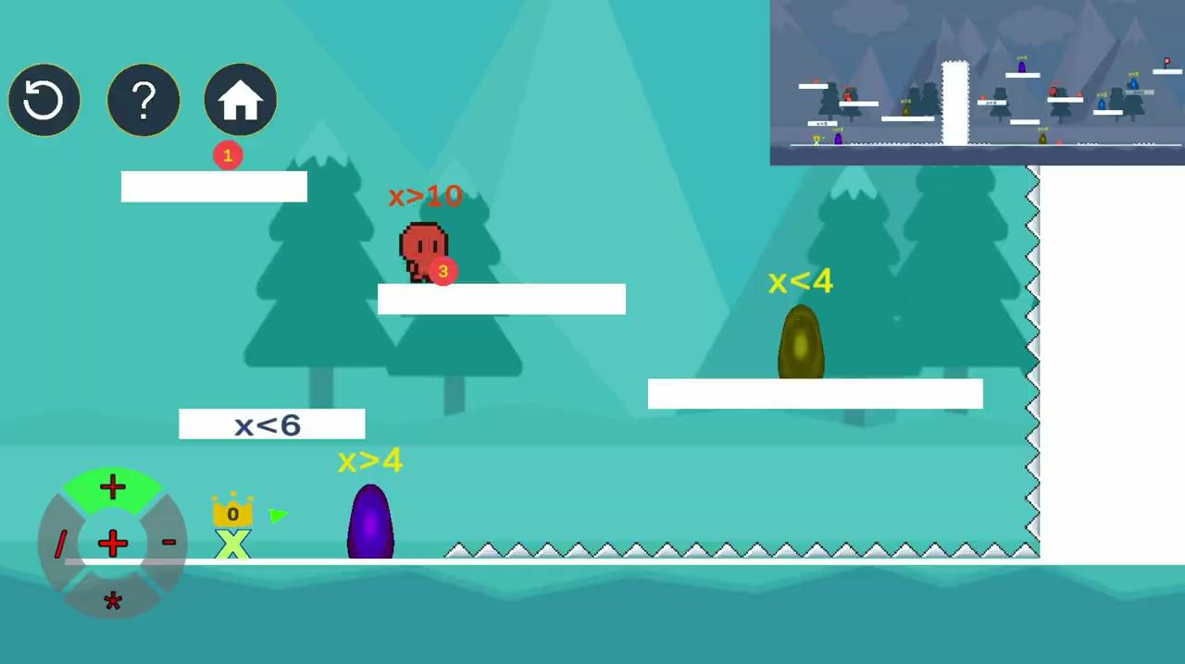
BETA
GOLD

Slide 22
4
FLEXIBILITY

Slide 23
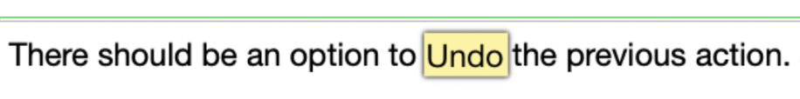
hypothesis
solutions
There’s no way to undo previous calculations
Number can only be used once, making it less error tolerant.
PUT DATA ANALYTICS HERE
Add respawn mechanic to numbers
Respawn can be used for undo or calculation
Limit the respawn time to prevent abuse

Slide 24

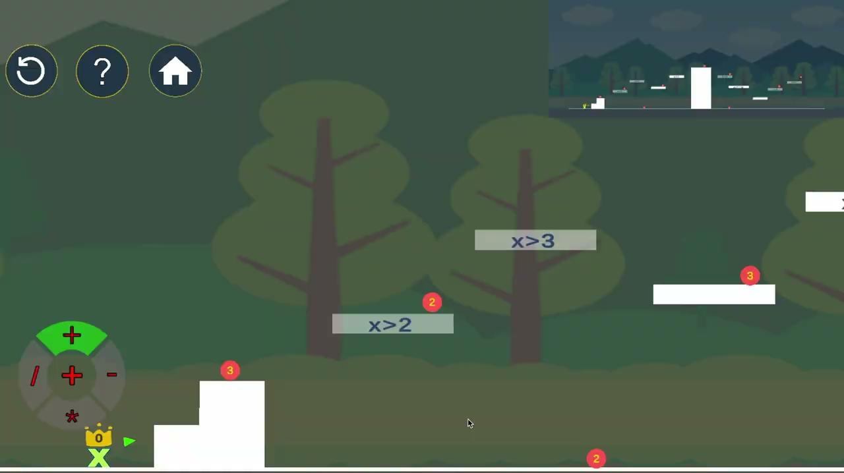
BETA
GOLD
INSERT VIDEO HERE
INSERT VIDEO HERE

Slide 25
UI

Slide 26
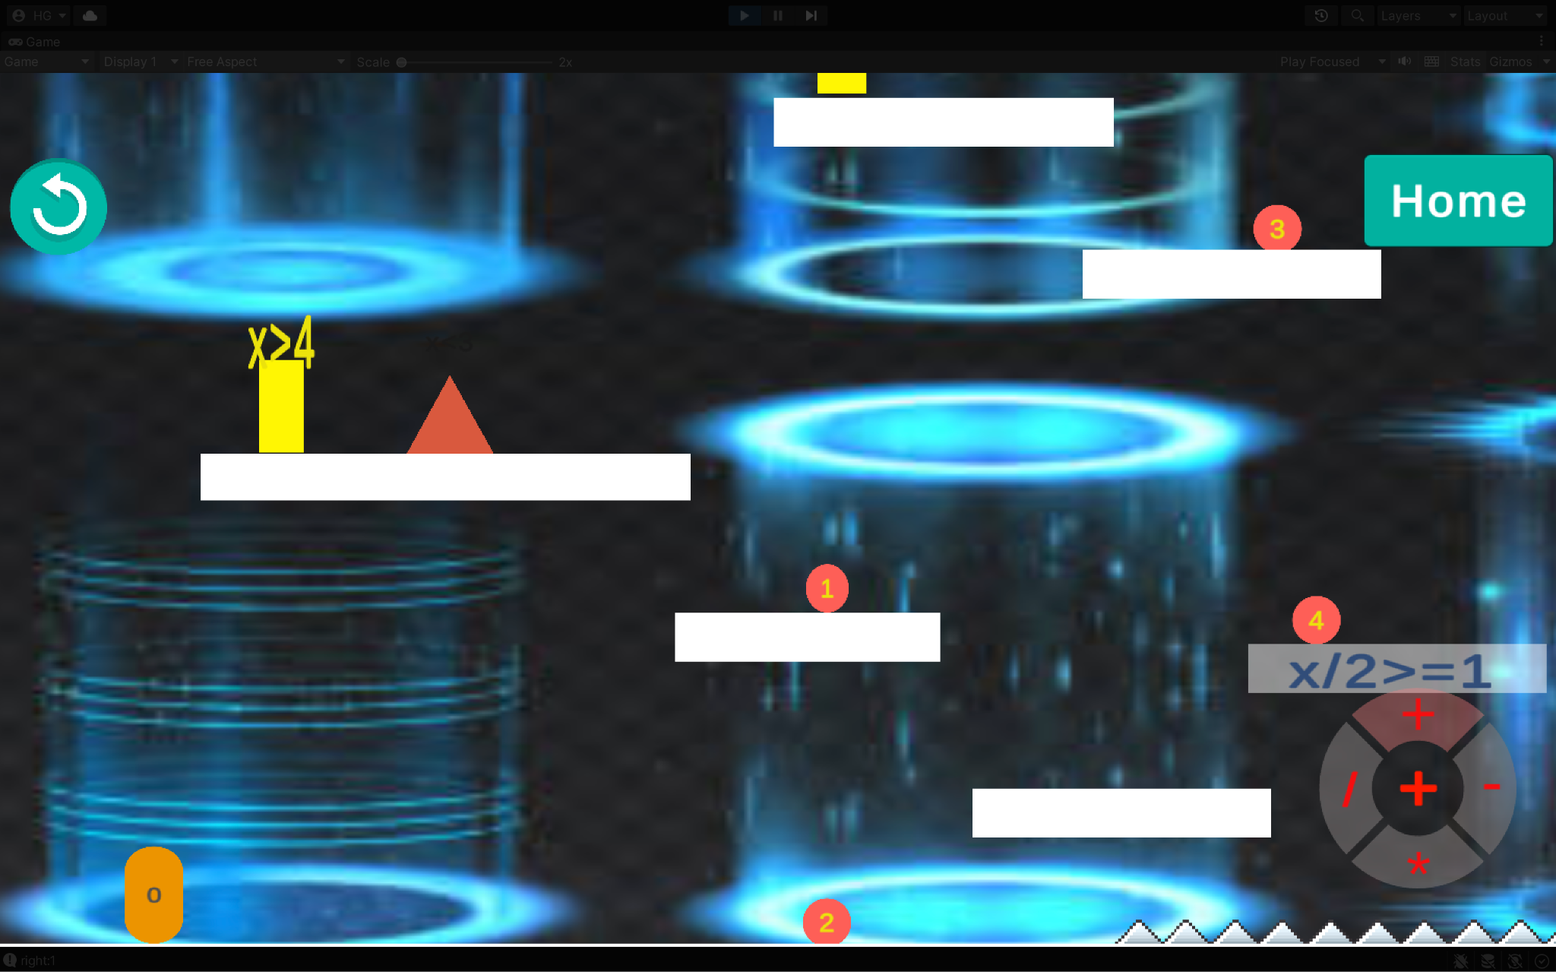
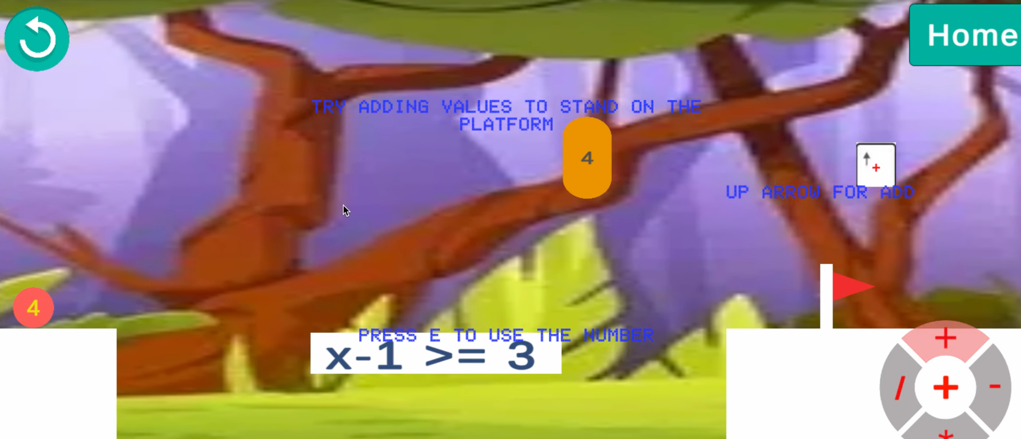
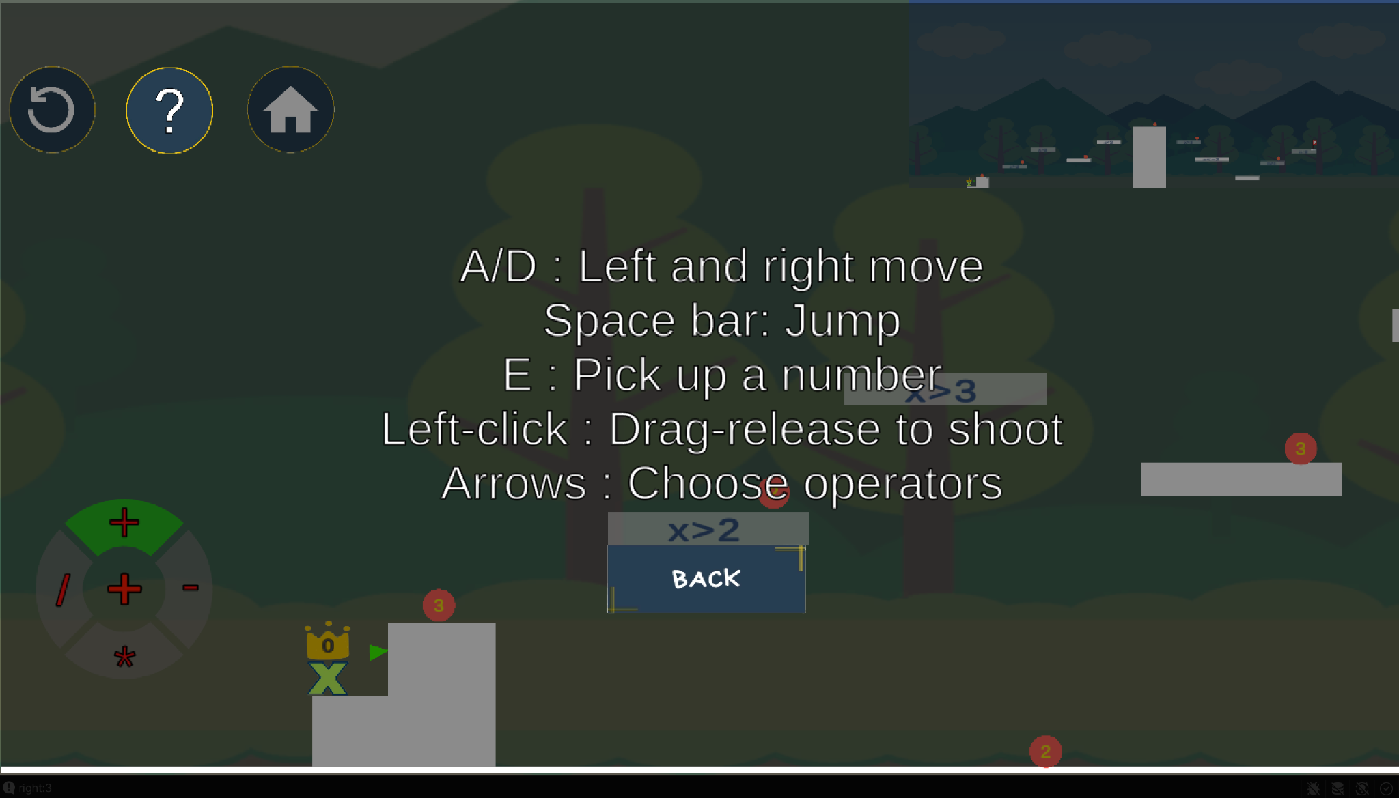
BETA
GOLD
INSERT VIDEO HERE

Slide 27
HIGHLIGHTS
Core mechanic and its interaction
Respawn
Inverse Gravity
Drag and shoot

Slide 28
The end.
thanks!
MAMACHICK

Slide 29
_add video here
Current Tutorial

Slide 30
IMPROVEMENTS
Beta
UI
Less text
Font: size & color
Less kill
LEVEL DESIGN
Carefully designed paths to make sure players get familiar with basic operations.
Gold
_ADD ss HERE

Slide 31

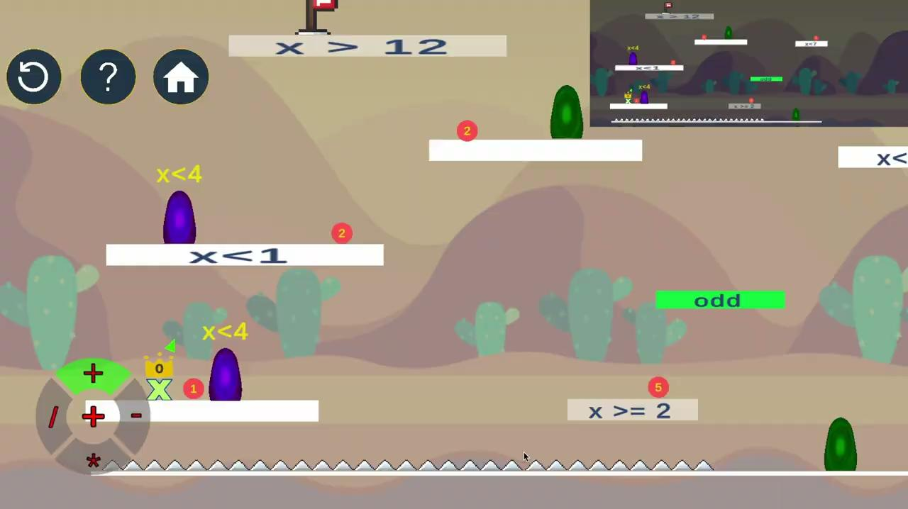
BETA
GOLD

Slide 32
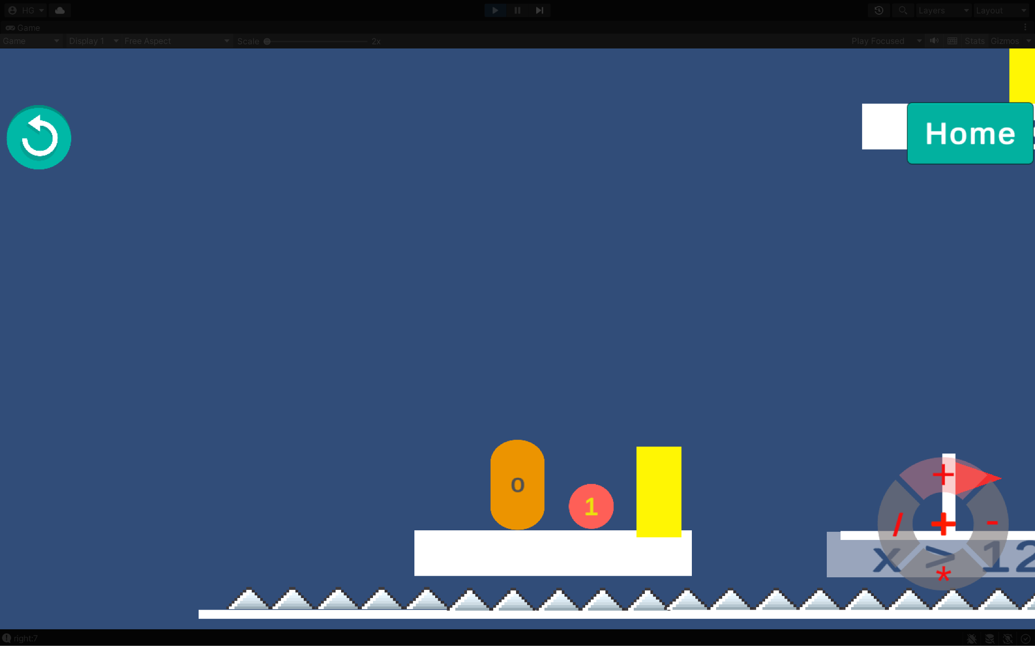
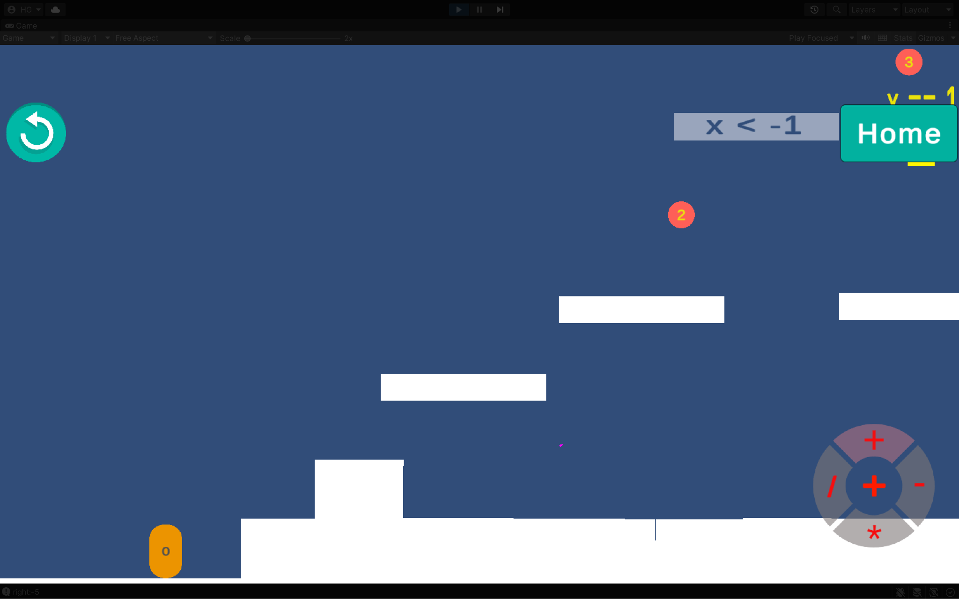
_put clip for previous UI here
Previous UI

Slide 33
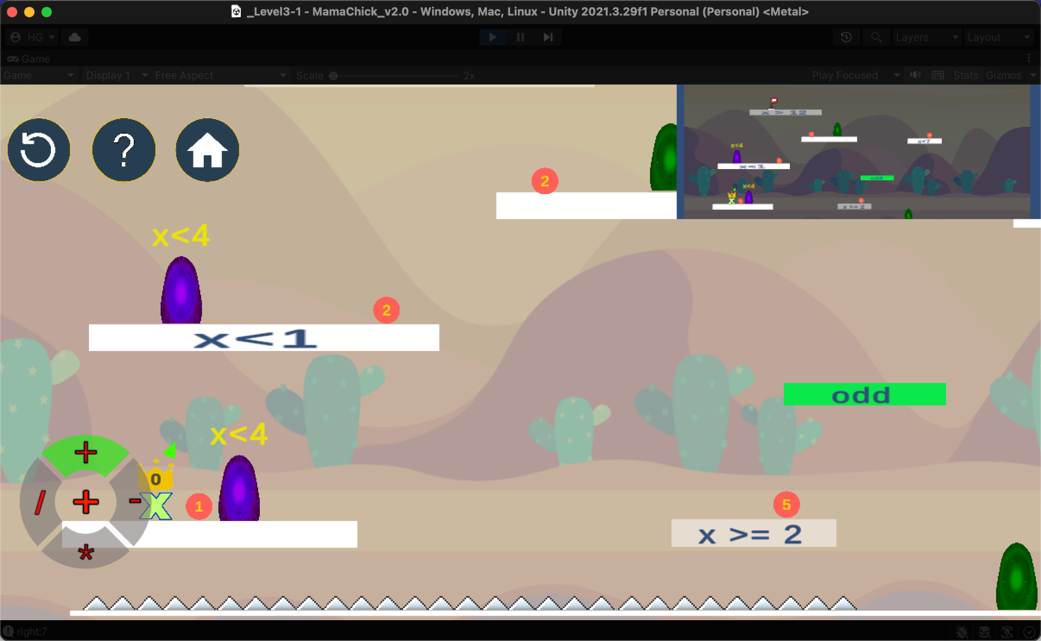
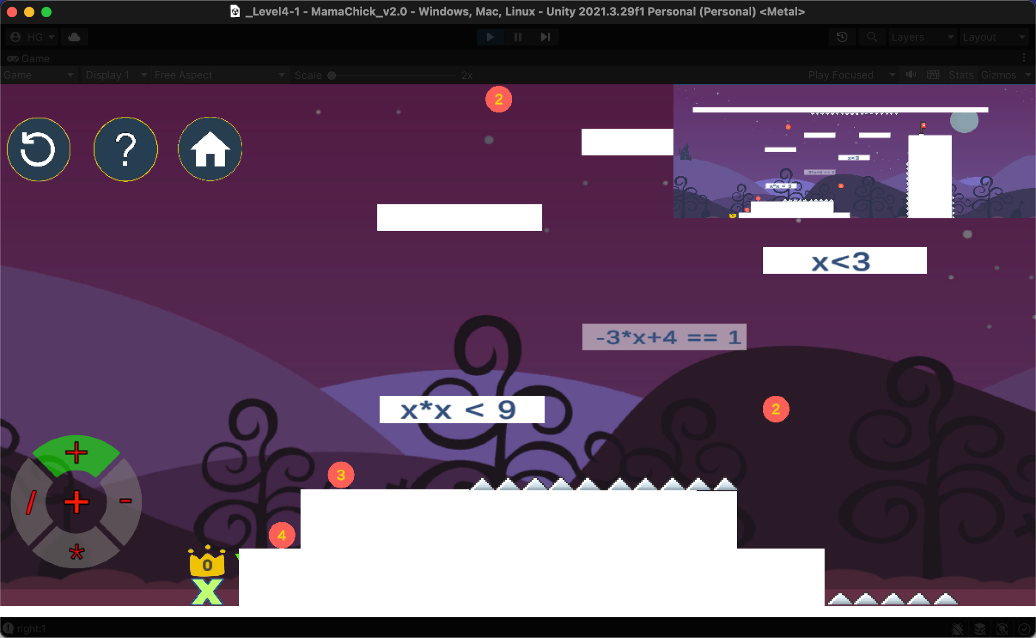
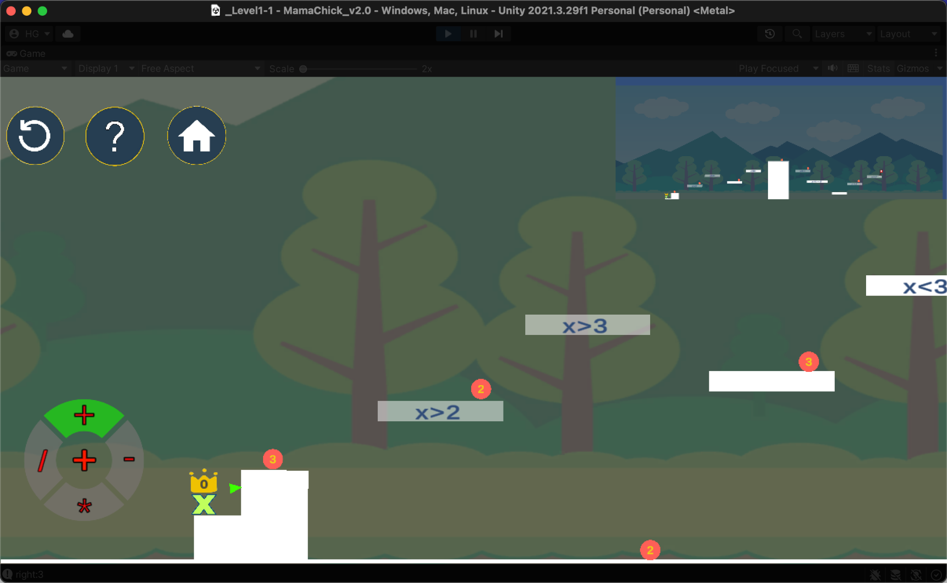
_add current ui here
Current UI

